Slide 1
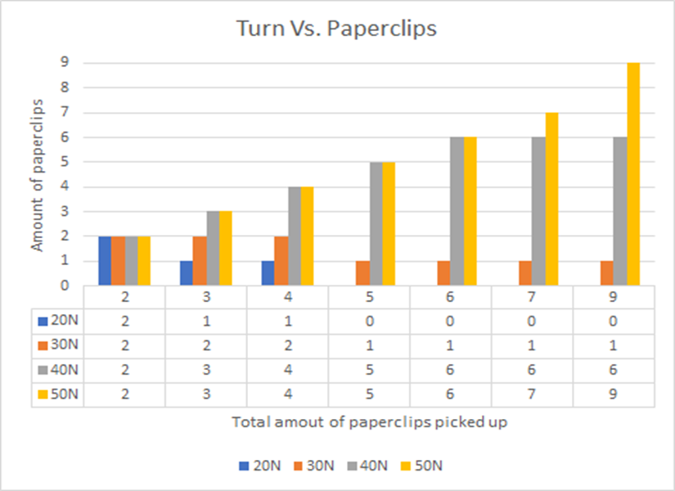
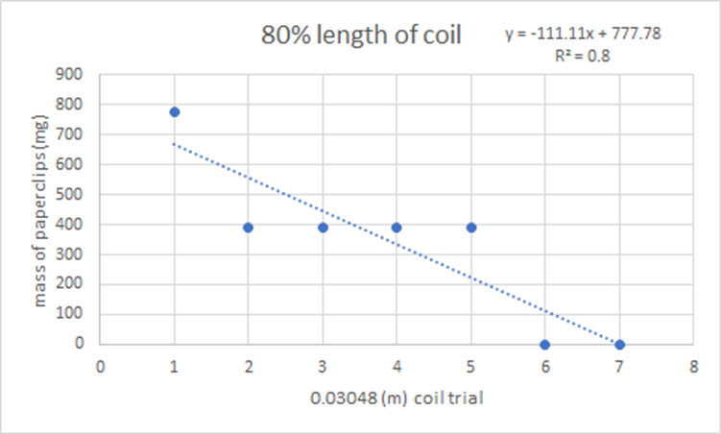
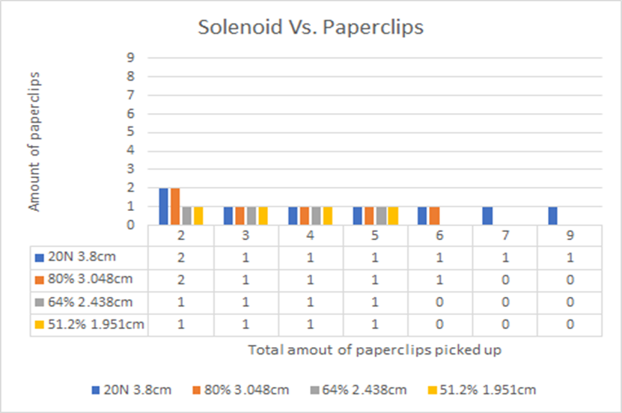
An Investigation of Electromagnet: The Application of Electric Force and Circuits
Andre Parmer, Benjamin Stewart, Jessica Rojas, Linda Michaels and Shaily Nieves-Adame
Experiment 1 Procedures:
Investigating how the number of turns in our solenoid affects the B field. Get data from 20 turns from Part 1. Wrap 1 nail with 30 turns, before connect wire to 1 D batter (1.5V). Pick up as many paperclips as you can. Connect to 1.5 V battery Does it pick up at both ends. Pick up as many paperclips as you can Change number of turns to 50 turns, N, over the same length, L connect to 1.5 V battery Pick up as many paperclips as you can. Repeat this procedure for 3,5,7 and 9 nail bundles
Experiment 2 Procedures:
Investigating how the length of the solenoid affects the B field. Get data for 20 turns, N, and the other measures from part 1. On the 1 nail, decrease the length, L, of the 20 turns to 80% (keeping 20 turns, N). Connect to a 1.5V battery Pick up as many paperclips as you can. Decrease the length, L, of the 20 turns, N, down to 80% of that length. Pick up as may paperclips as you can. Decrease the length, L, of the 20 turns, N, down to 80% of that length. Pick up as many paperclips as you can. Repeat for 3,5,7 and 9 nail bundles.
The purpose of this laboratory experiment was to create a temporary electromagnet using copper wire tightly coiled around a fluted nail and connected to a D-battery. Theoretically, electrical current should pass through the copper coil once it connects to the ferromagnetic object, in this case a D-battery. This was done so the electrical current, created a magnetic domain with the ability to be turned on or off. The experiment was broken down into two parts, where different modifications were made to the temporary electromagnet in order to test and observe the strength when picking up different number sets of standard sized paperclips. The hypothesis states that if the temporary electromagnet has a maximum number of copper wire coils, the magnetism will increase, in turn, resulting in a stronger pull of paperclips.
Experiment 1
Experiment 2
PROCEDURE
INTRODUCTION
RESULTS
Experiment 1 represents how the number of coils on an electromagnet will increase the strength of the magnetic field. The experiment shows that 50 coils proved to have the strongest magnetic field as it consistently picked up and held onto more paper clips compared to 40, 30, 20 coils. We did the experiment in the opposite order, so as the experiments were done the electromagnet would continue to get stronger as more coils were wrapped. The trial with 20 coils did not pick up many paperclips while the electromagnet with 50 coils picked up almost all the nails. Experiment 2 represents how the length of solenoids will affect the strength of the electromagnet. The data informs that the shorter the solenoids were, the stronger the magnet was. The experiment uses a 20-coil warp electromagnet with solenoids from 3.048Cm, 2.38Cm, and 1.95Cm. The 3cm solenoid only grabbed paperclip for the first 3 chains however the solenoid with 1.9Cm grabbed one paperclip on all the chains. This shows that small changes in the solenoid can increase and decrease the strength of the magnetic field.
Overall, the number of coils wrapped around the electromagnet and the length of the solenoid allowed both have strong and major effects to the electromagnet. As the length of the solenoid shortens and the more coils increase, the electromagnetic field increases, and as the coils decrease and the solenoids length increases, the electromagnetic field decreases. This indicates that the number of coils is directly related to strength while the length of solenoids is indirectly related.
CONCLUSION

